Slide 1

Text Analysis
Notes:
NOTE:
To change the image on this slide, select the picture and delete it. Then click the Pictures icon in the placeholder to insert your own image.

Slide 2
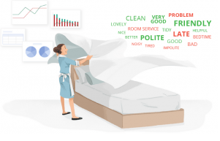
Natural Language Processing (NLP)
NLP is broadly defined as the automatic manipulation of natural language, like speech and text, by software.
NLP help analysts to turn unstructured text into usable data and insights.
It is built under NLTK library.

Slide 3
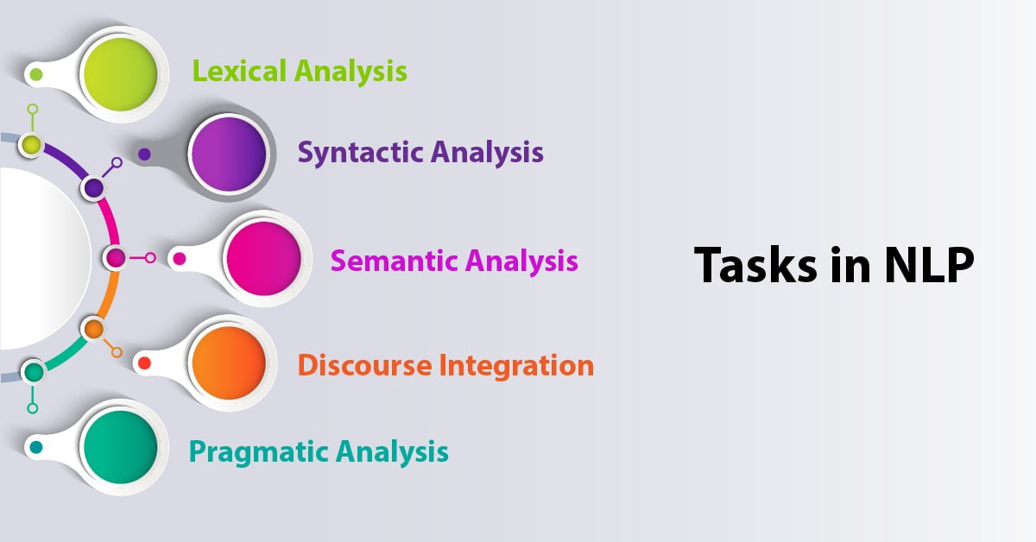
Ref: https://medium.com/@rinu.gour123/nlp-tutorial-ai-with-python-natural-language-processing-ed81fdb3f0a3

Slide 4
KPIs for Analysis
Number of reviews
Price
Minimum Nights
Total Net Revenue = [Number of reviews] x [Price (USD)] x [Minimum nights]

Slide 5
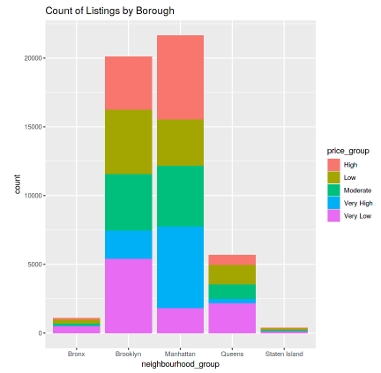
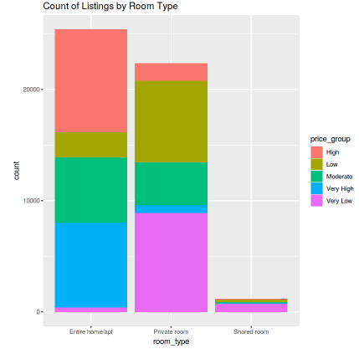
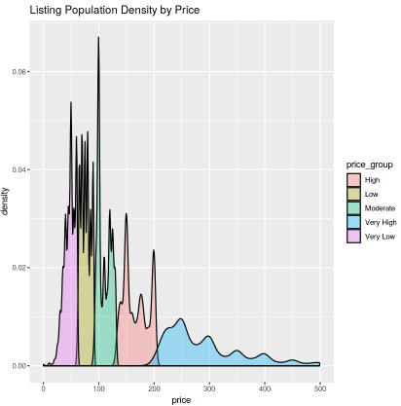
Exploratory Data Analysis

Slide 6
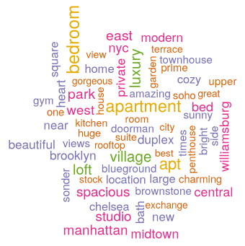
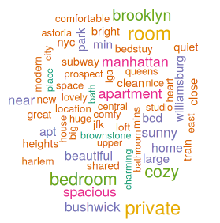
Word Clouds
High Price
Low Price
Main Words: Luxury, Loft and Village
Main Words: Cozy, bedroom and private

Slide 7
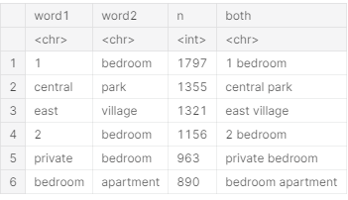
Bigrams of Titles

Slide 8
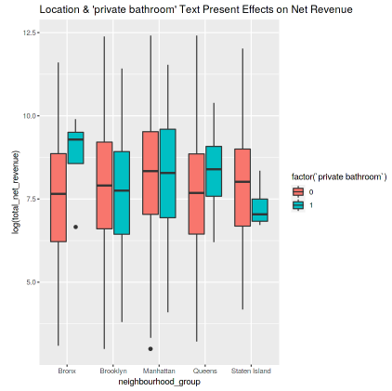
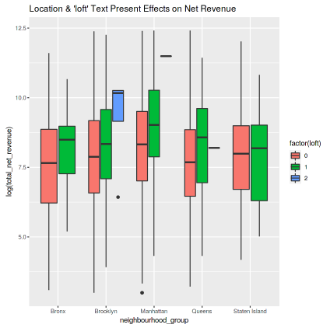
Titles effect on Revenue

Slide 9
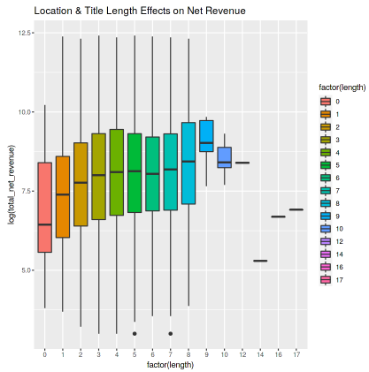
Titles effect on Revenue

Slide 10
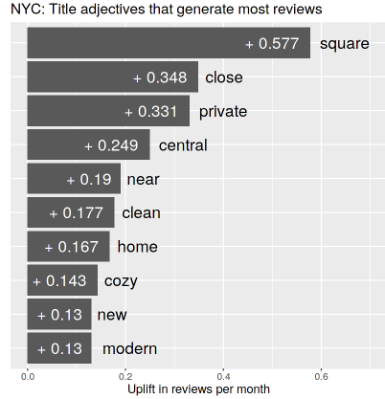
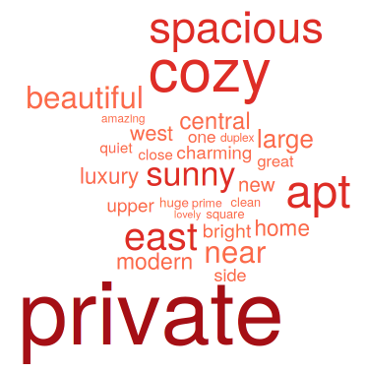
Titles effect on Reviews

Slide 11
Key Takeaways
The text that you put in your property title DOES matter
It varies across what region you are located in. It is important to include specific text, especially if your property contains it.
Ex: if you're near Central Park - put that in the title!
If you're a high rated Host, and your property is also highly rated, you are most likely going to succeed in obtaining a larger net revenue!

